Slide 1

Case Study: Intelligent Systems (WS25/26)
Predictive Maintenance of Milling Machines
Lecturer: Hamidreza Heidari
Members: Irtaza Janjua, Soman Tariq, Sadeed Ahmad, Usama Ali

Slide 2
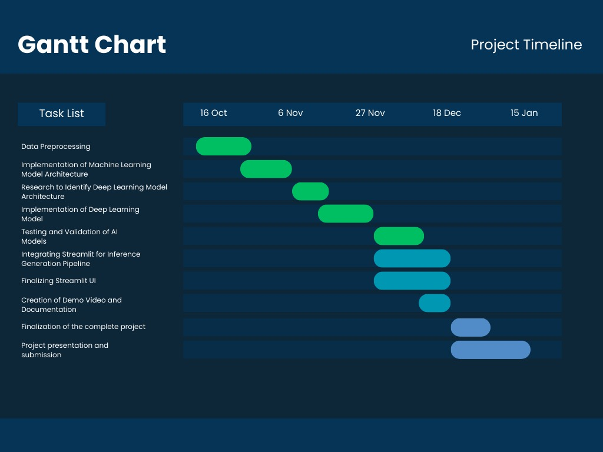
Project Timeline

Slide 3
Project Overview
Predictive Maintenance (PdM) for milling machines using sensor data
Goal: Predict machine failure and identify failure patterns early
Motivation: Reduce costly unplanned downtime and enable Industry 4.0 data-driven maintenance
Dataset: UCI Predictive Maintenance dataset

Slide 4
Project Overview
Industrial Problem
Milling machines are critical production assets
Unexpected machine failures lead to unplanned downtime, production delays, and high maintenance costs
Traditional preventive maintenance often replaces components too early or too late
Main Goal
Use machine sensor data (e.g. temperature, torque, vibration) to Detect early signs of machine degradation
Predict failures before breakdown occurs, enabling planned maintenance

Slide 5
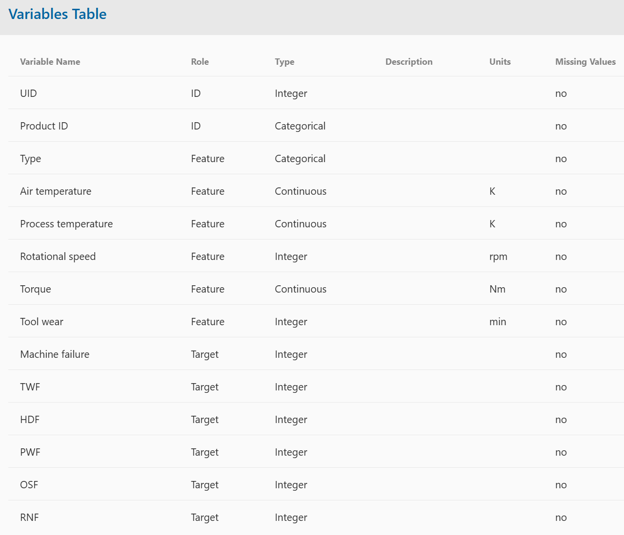
Recap: Data Understanding
10,000 samples (unique IDs).
Type: Quality categories — Low (50%), Medium (30%), High (20%).
Air Temperature (K)
Process Temperature (K)
Rotational Speed (rpm)
Torque (Nm)
Tool Wear (min)
Targets:
Target 1: Machine Failure (Yes/No)
Target 2: Failure Type (categorical)
Tool wear failure (TWF)
Heat dissipation failure (HDF)
Power failure (PWF)
Overstrain failure (OSF)
Random failures (RNF)

Slide 6
Data Understanding
Data Source
Industrial milling machine operating data
10,000 machine operating cycles
Three machine quality levels:
Low (50%), Medium (30%), High (20%)
Monitored Machine Signals
Air temperature [K]
Process temperature [K]
Spindle speed (rpm)
Torque (Nm)
Tool wear (min)
Maintenance Targets
Machine failure: Yes / No

Slide 7
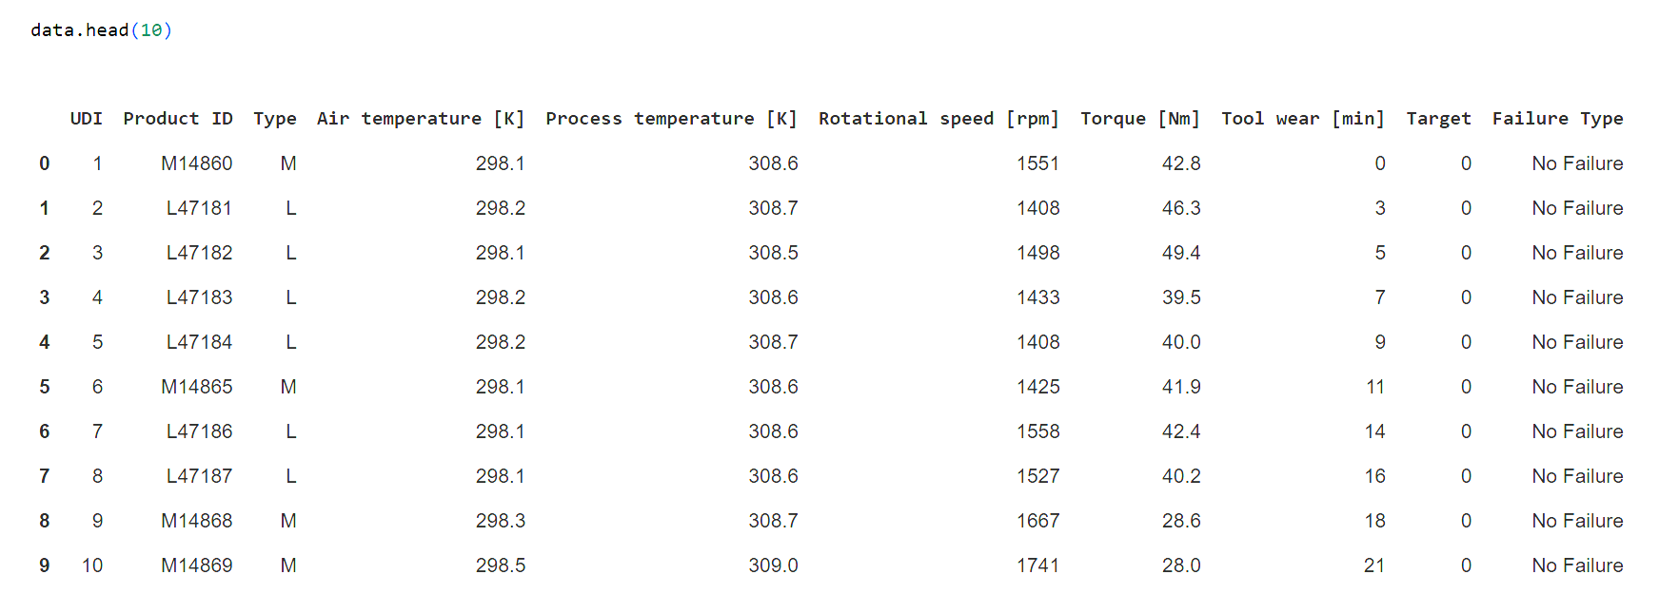
Recap: Data Exploration (CODE)

Slide 8
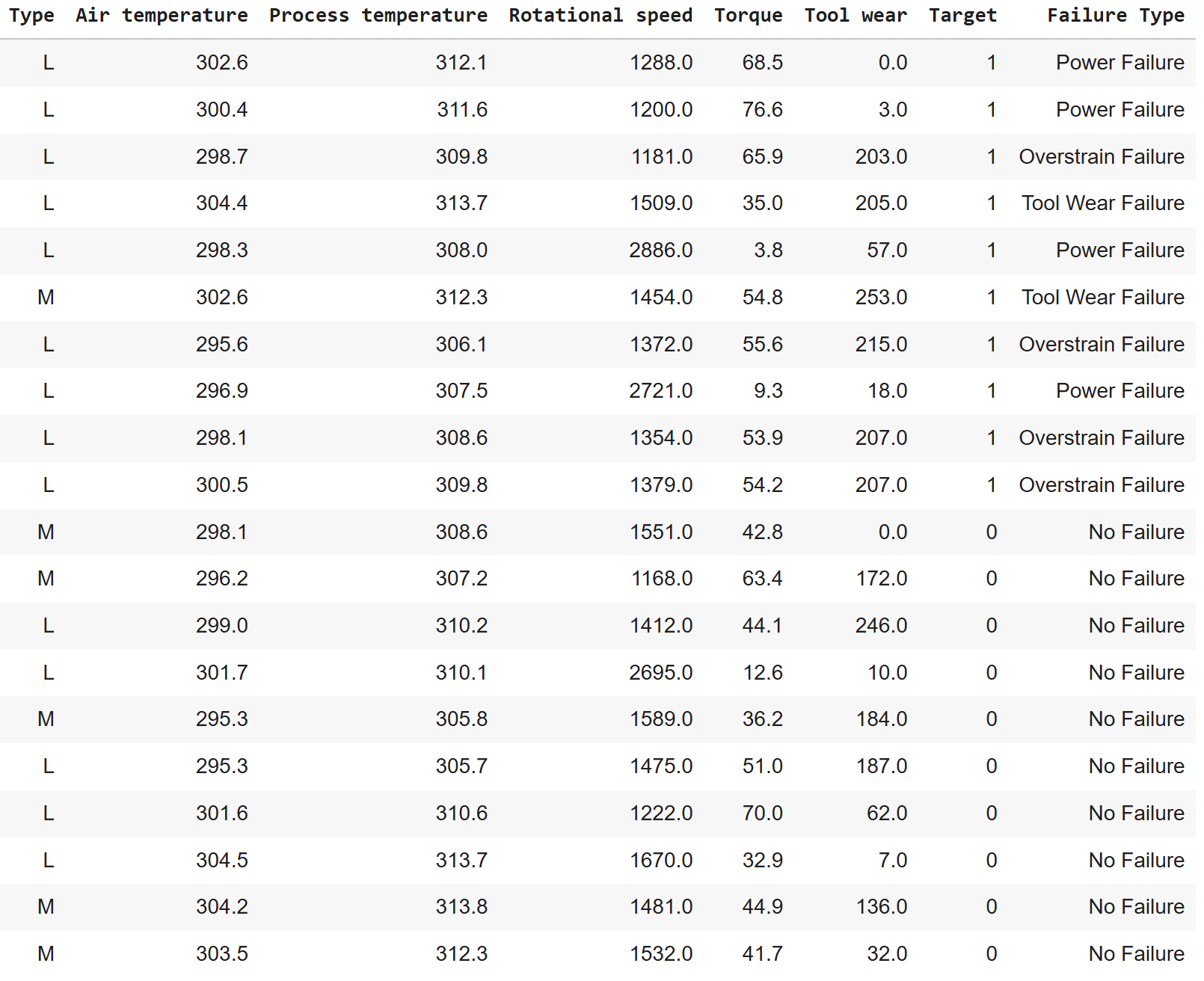
Data Exploration

Slide 9
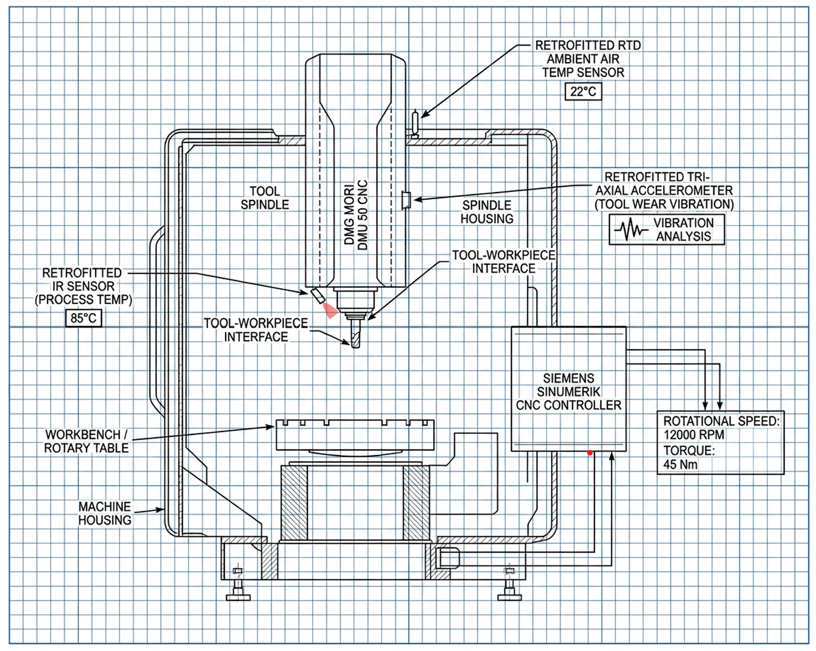
DMU 50

Slide 10
Motivation for Deep Learning
Data Balancing Strategy
Machine failures represent 3.57% of observations
Applied SMOTE to oversample minority failure classes
Generated synthetic samples for each failure mode
Final class distribution ≈ 75% normal / 25% failure
Feature Reduction & Interpretation
Applied PCA on numerical sensor features
Top 3 principal components capture most variance:
PC1: Temperature-related behavior
PC2: Mechanical power (speed × torque)
PC3: Tool wear progression
Modeling Strategy
Start with an interpretable baseline model
Introduce a more expressive model for complex nonlinear patterns

Slide 11





Methodology flowchart
Preprocessing
Data cleaning and missing value correction
Handling class imbalance using SMOTE (Synthetic Minority Oversampling Technique)
Implementation of PCA (Principal Component Analysis) for Feature Engineering
Tools:
Modeling
Train Random Forest classifier
Train Deep Learning Model
Sensor data used as input to predict failures
Validation
Evaluate model performance using Accuracy, Precision, Recall, F1-score
Confusion matrix shows which failures are predicted well
Deployment
Predictions displayed on a Streamlit dashboard
User-friendly and easy to monitor
21.12.2025
11

Slide 12
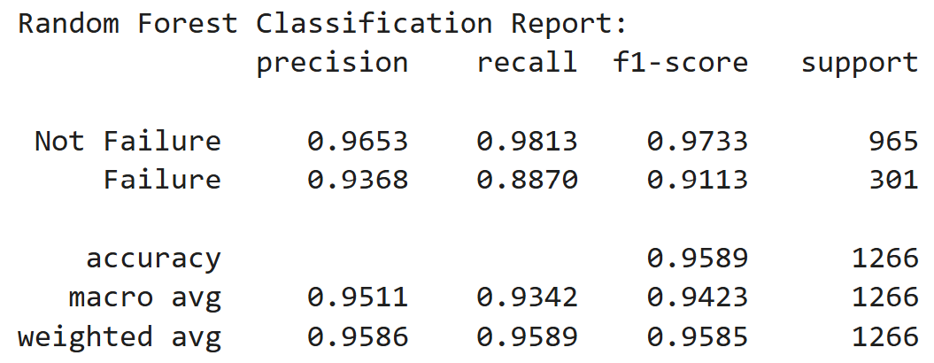
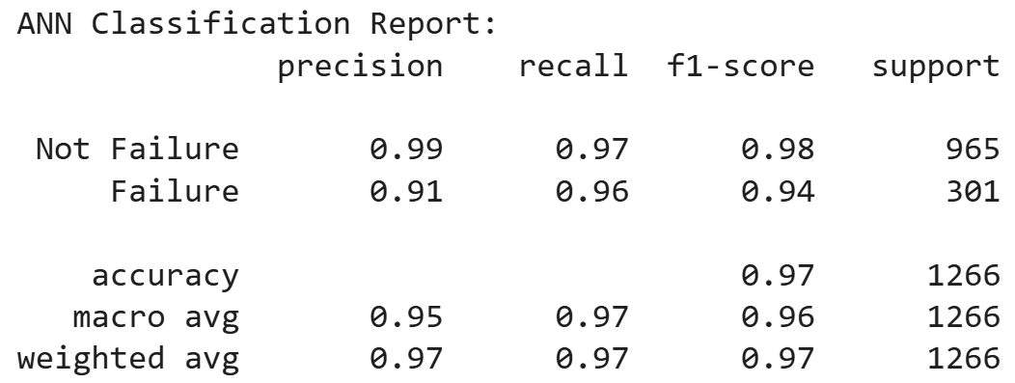
Results
ANN shows stronger overall performance, improving the accuracy from 95.9% to 97.4%.
The ANN drastically improves recall on the Failure class, which is the single most important metric in predictive maintenance.
RF remains strong and interpretable, but ANN captures deeper nonlinear patterns, especially in rare failure conditions.
ANN provides a better balance between both classes, resulting in higher macro and weighted F1-scores.

Slide 13
Performance Comparison: Our Results vs. Literature
[1] Carvalho et al., 2019 Systematic Review of ML in PdM
Random Forest
Accuracy: 92%
Recall: 89%
[2] Sujata Butte, Prashanth A. R., and Sainath Patil, 2018 — Machine learning based predictive maintenance strategy: a super learning approach with deep neural networks.
Deep Learning Architecture
Accuracy: 94.5%
Recall: 91.5%
Our Results
Random Forest
Accuracy: 95.89%
Recall: 93.4%
Deep Learning Architecture
Accuracy: 97.39%
Recall: 97.0%
21.12.2025
13

Slide 14
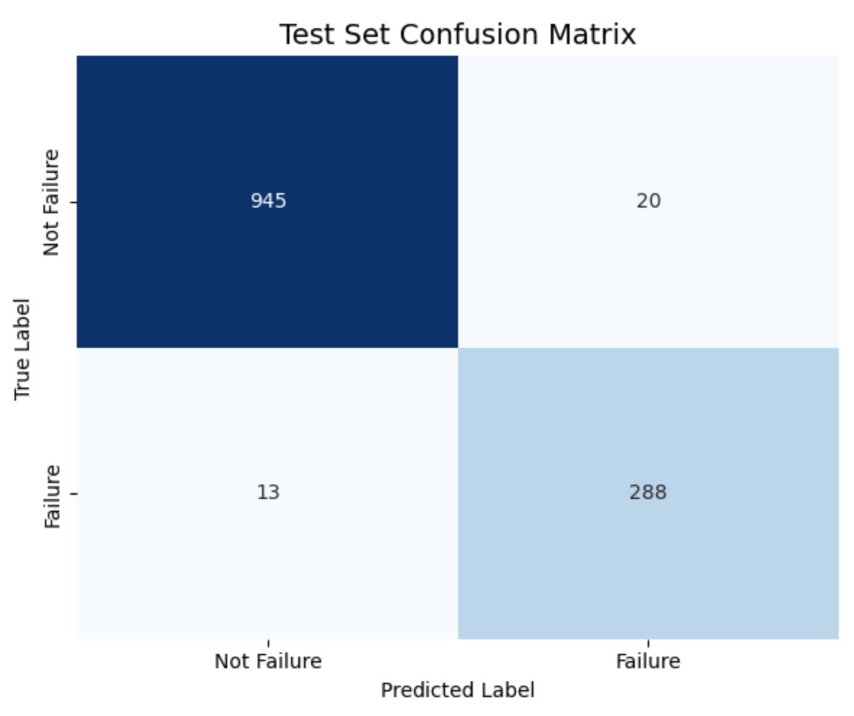
Validation
Validation Approach
Model inference evaluated on held-out test dataset
Predictions compared with actual machine failure labels to verify performance
Why Validation is Reliable
Test data not seen during training, ensuring unbiased assessment
Performance metrics (accuracy, recall) demonstrate the model effectively detects failures

Slide 15
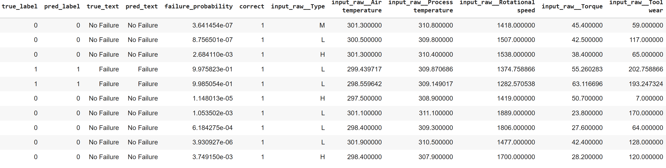
Validation

Slide 16
Outcomes
Implemented a data preprocessing and visualization pipeline to generate insights.
Trained and validated ANN-based predictive maintenance model
Inference pipeline implemented (preprocessing + prediction)
Interactive Streamlit app for real-time failure prediction from sensor inputs
Created a reference predictive maintenance framework that can be adapted to different milling machines by mapping corresponding sensor inputs.

Slide 17
Recap: Initial Data Exploration
Checked for missing values → none found.
Checked for duplicates → none found.
Identified 6 numeric and 3 categorical features.
Converted numeric columns to float type for consistency.
Removed UDI and Product ID
Found labeling inconsistencies:
Random Failures (RNF) were not marked as machine failures.
Corrected target values to set Target = 1 for RNF.
Removed ambiguous records (9 rows) where Machine failure = 1 but no specific failure cause was given.

Slide 18
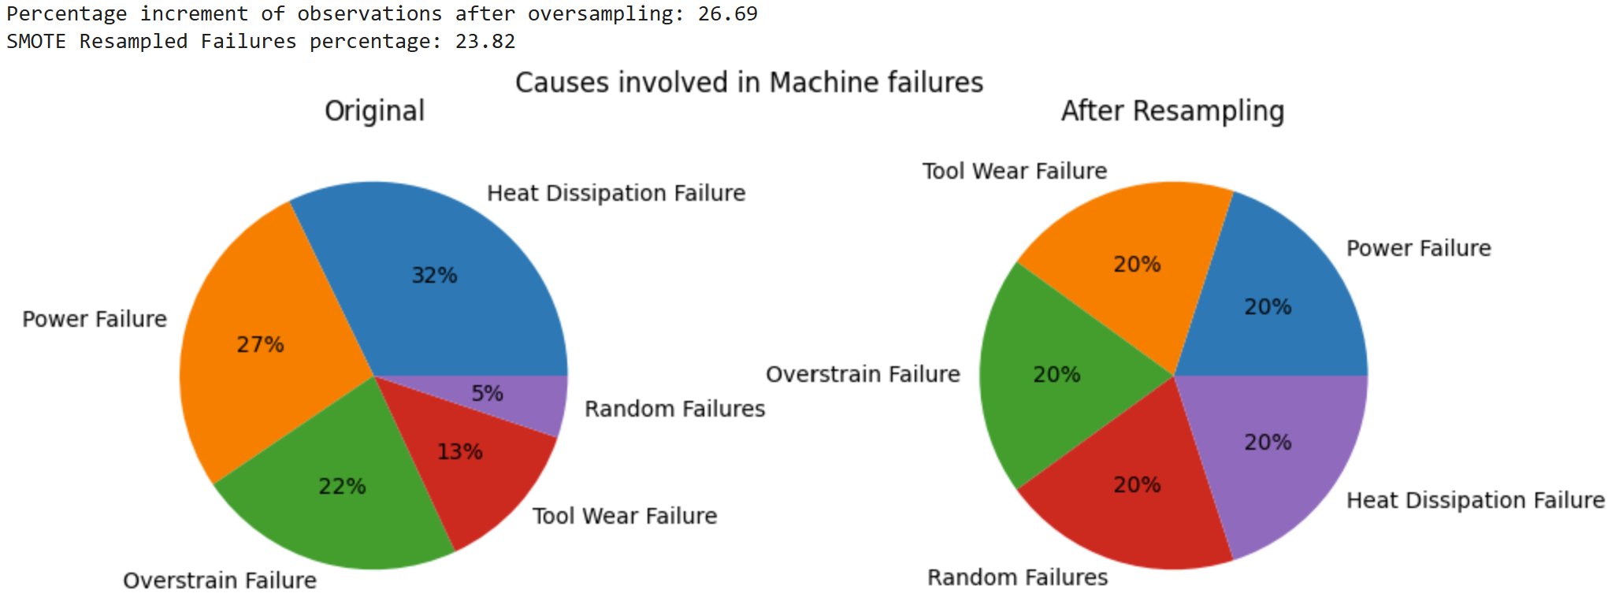
Recap: Handling Class Imbalance (SMOTE)
Only 3.57% of observations were machine failures.
Applied SMOTE (Synthetic Minority Oversampling Technique):
Generated synthetic samples for minority failure modes.
Balanced data to ~75:25 ratio (working:failure).
Achieved uniform representation across all failure types.

Slide 19
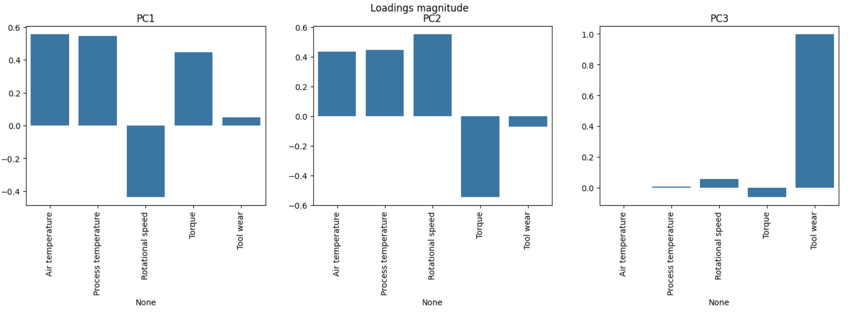
Recap: Principal Component Analysis
Applied Principal Component Analysis (PCA) on numeric features.
Top 3 PCs explain most of the variance.
Interpretation:
PC1 → closely related to the two temperature features
PC2 → can be identified with the machine power, which is the product of Rotational Speed and Torque
PC3 → Tool Wear

Slide 20
Recap: Baseline Model
Selected Random Forest as the baseline due to strong performance in PdM literature.
Robust to noise, handles mixed feature types, and offers interpretability.
Achieved 95.9% accuracy, but the recall on the failure class was only ~88%, which is a significant drawback since missing failures is costly in predictive maintenance.

Slide 21
Motivation for Deep Learning
Literature shows Neural Network Architectures excel in PdM for modeling complex nonlinear patterns in sensor data.
Neural networks can capture higher-order interactions among temperature, torque, speed, and tool wear.
Neural Networks can generalize better under noise and extreme operating conditions typical in industrial data.
Provides a complementary modeling approach to tree-based methods → allows benchmarking and performance comparison.

Slide 22
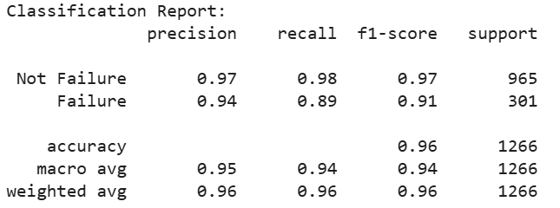
Initial Neural Network Architecture
Implemented a feed-forward Artificial Neural Network
2 hidden layers: 128 → 64 neurons
ReLU activations + Dropout(0.3)
Softmax output layer
Trained with Adam + EarlyStopping

Slide 23
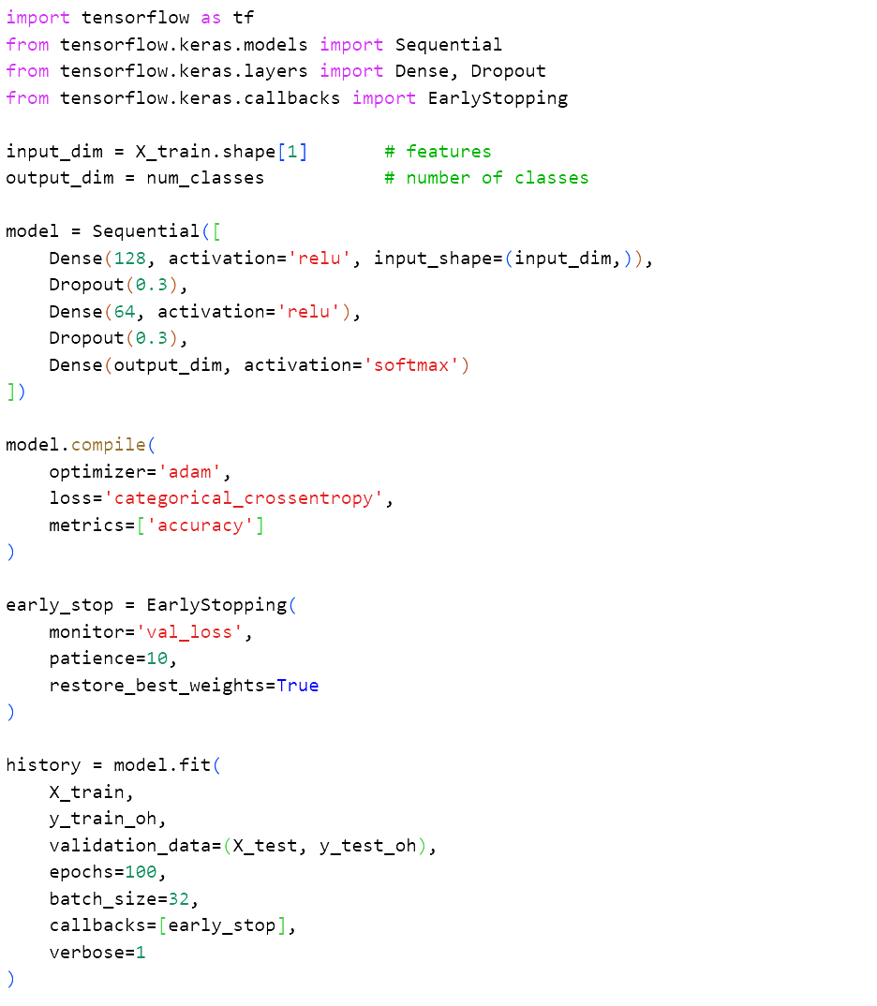
Initial Neural Network Architecture (CODE)

Slide 24
Advanced Neural Network Model
Implemented a deep feed-forward Artificial Neural Network
ANN Architecture: 5 hidden layers with 512 → 256 → 128 → 64 → 32 neurons, followed by a softmax output layer.
Stacked dense layers with:
ReLU activation → prevents vanishing gradients, fast and stable training.
Batch Normalization → stabilizes distributions across layers, speeds convergence.
Dropout → reduces co-adaptation, improves generalization.
L2 weight regularization → penalizes overly large weights, controls model complexity.

Slide 25
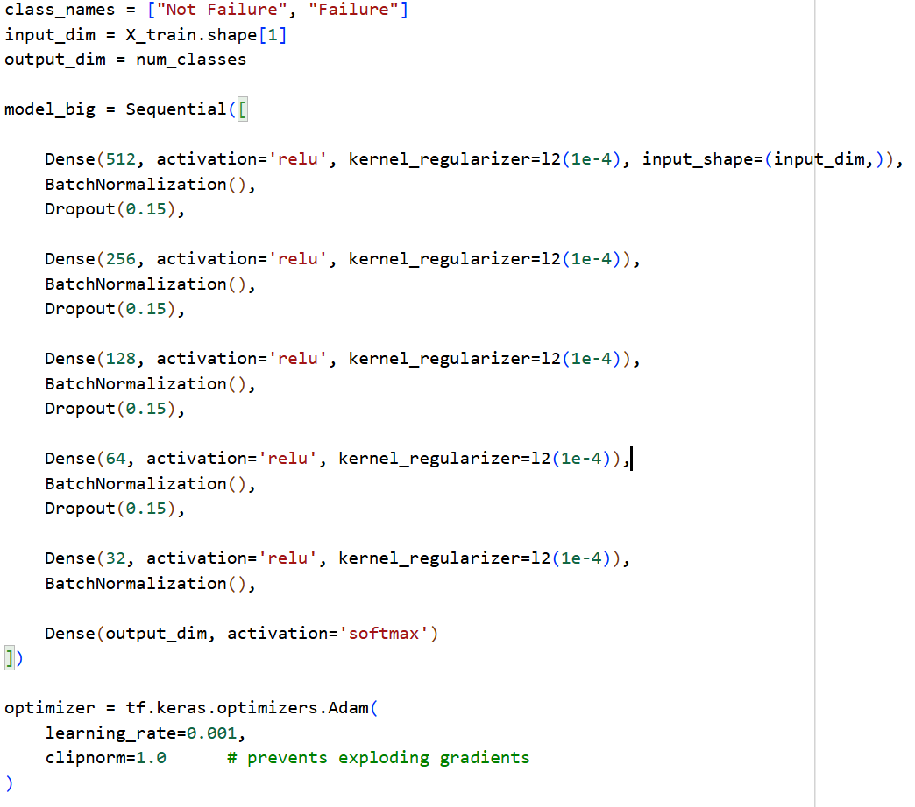
Advanced Neural Network Architecture (CODE)

Slide 26
Training Strategy
Adam optimizer: adapts the learning rate automatically, helping the model learn steadily and efficiently.
Early Stopping: stops training when validation performance no longer improves, preventing overfitting and keeping the best model.
Learning Rate Reduction: lowers the learning rate when progress slows, allowing finer adjustments during later training stages.
Batch size (32): balances training stability and computation speed.
Epoch limit (200): high flexibility, but training usually stops earlier due to Early Stopping.

Slide 27
Future Work
Move from model training to deployment phase
Build an inference pipeline to process real machine sensor inputs
Develop an interactive PdM dashboard using Streamlit where users can input data and receive predictions

